Slide 1

Grocery Store Management
Presented by :
P.Santhosh Kumar
Batch No : 504

Slide 2
About me
Background:
I completed my Bachelor of Technology in CSE from Sandip university.
Why you want to learn Data Science:
I want to learn data science to improve my skills and get high payeable job.
Any work experience:
So, far I have no experience
LinkedIn : www.linkedin.com/in/puppala-santhosh-kumar
GitHub : https://github.com/santhoshkumarpuppala77-bot

Slide 3
Agenda
Business Problem
Problem Statement
Introduction
ER Diagram and Schema Explaination
SQL Queries Results
Business Key Insights
Conclusion
Recommendations
Q & A

Slide 4
Business Problem
The grocery store generates large amounts of data related to customers, products, suppliers, employees, and sales. However, without a centralized database and analytical system, it becomes difficult to track performance, identify sales trends, monitor inventory, and make informed business decisions that improve profitability and operational efficiency.

Slide 5
Problem Statement
Develop a SQL-based Grocery Store Management System that integrates customer, product, supplier, employee, and order data into a relational database. The system should enable efficient data management and analysis, helping stakeholders identify top-performing products, valuable customers, sales trends, supplier contributions, and employee performance for better decision-making.

Slide 6
Introduction
The Retail and Grocery domain involves the management of inventory, suppliers, customer orders, employees, and product categories. Effective data management in this domain allows businesses to:
Track sales and revenue
Monitor product availability
Analyze customer and employee activity
Improve operational efficiency
This project simulates a mini grocery store database where various entities such as products, suppliers, customers, and orders interact. Students will use SQL to perform data extraction, transformations, and derive business insights.

Slide 7
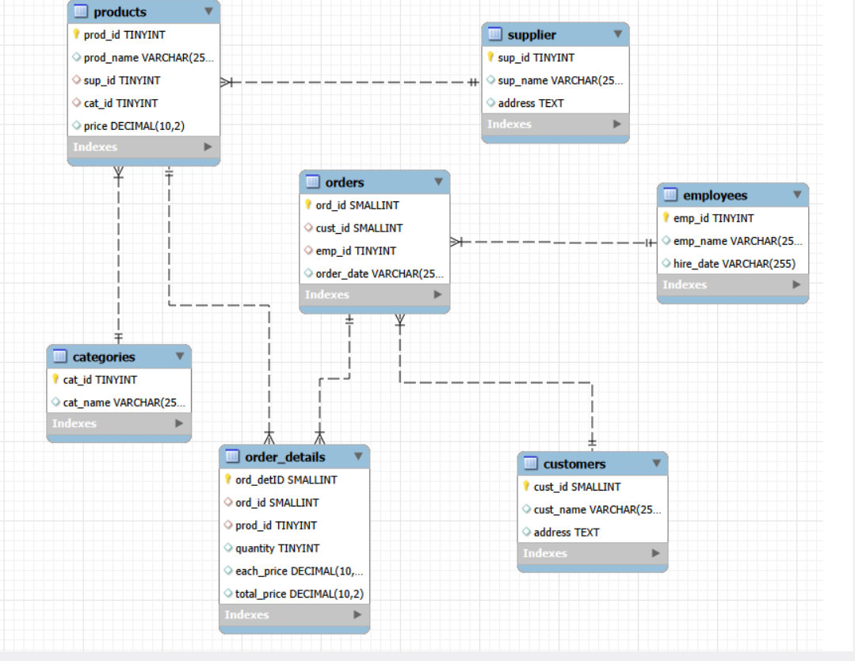
ER Diagram and Schema Explaination
Parent Table | Child Table | Cardinality
Supplier | Products | 1 : Many (1:N)
Categories | Products | 1 : Many (1:N)
Customers | Orders | 1 : Many (1:N)
Employees | Orders | 1 : Many (1:N)
Orders | Order_Details | 1 : Many (1:N)
Products | Order_Details | 1 : Many (1:N)

Slide 8
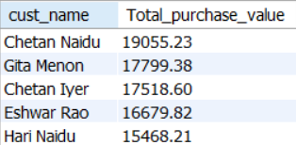
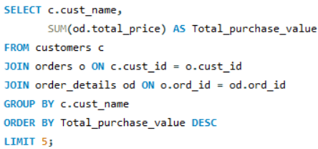
SQL Queries Results
01. Top 5 Customers by Total Purchase Amount :

Slide 9
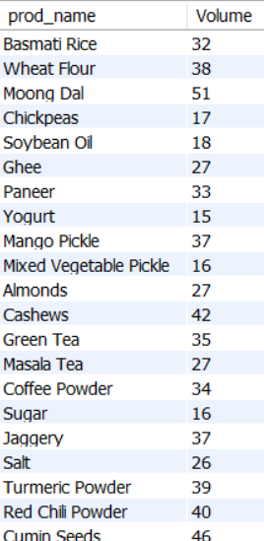
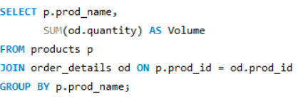
02. Best-Selling Products by Quantity :

Slide 10
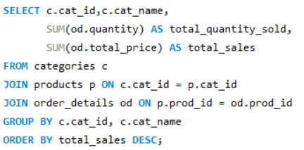
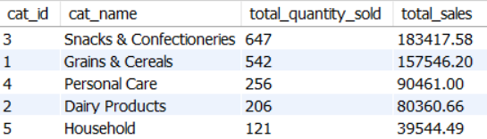
03. Category-wise Sales Analysis :

Slide 11
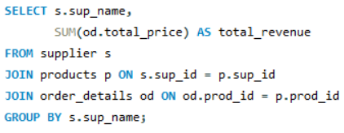
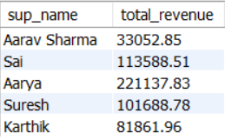
04. Supplier Contribution :

Slide 12
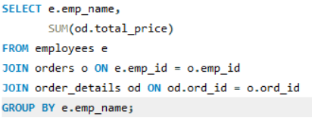
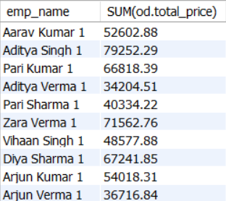
05. Employee Performance :

Slide 13
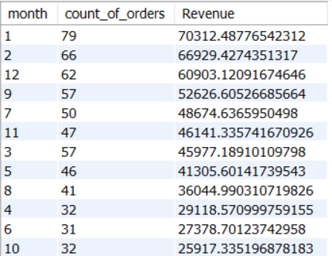
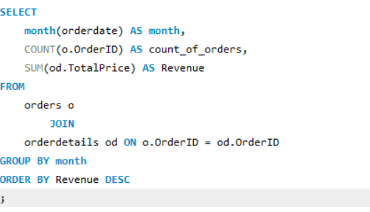
06. Monthly Revenue Trend :

Slide 14
Business Key Insights
Top customers contribute a major share of revenue, highlighting the importance of customer retention programs and personalized marketing strategies to maximize profitability.
A small number of products generate the highest sales and revenue, indicating that maintaining sufficient stock of these products is critical for business growth.
Product category performance varies significantly, enabling management to focus inventory and promotional efforts on high-performing categories.
Revenue contribution differs across suppliers, helping the business identify strategic supplier partnerships that support sales and profitability.
Employee sales performance is not uniform, suggesting opportunities to recognize top performers and improve overall productivity through training and incentives.
Sales and revenue trends reveal peak demand periods, allowing better inventory planning, staffing decisions, and marketing campaign scheduling to optimize operations and increase revenue.

Slide 15
Recommendations
Enhance Customer Retention: Introduce loyalty programs and personalized offers for high-value customers to increase repeat purchases and customer lifetime value.
Optimize Inventory Management: Maintain adequate stock levels for best-selling products and categories to avoid stockouts and maximize sales opportunities.
Focus on High-Performing Categories: Invest more in marketing and promotions for categories that generate the highest revenue and customer demand.
Strengthen Supplier Partnerships: Build stronger relationships with top-contributing suppliers to ensure product availability, better pricing, and reliable supply chains.
Improve Employee Performance: Recognize top-performing employees and provide training programs to improve sales effectiveness and customer service quality.
Leverage Sales Trends for Planning: Use sales and revenue trend analysis to forecast demand, optimize staffing, and schedule promotional campaigns during peak periods.

Slide 16
Conclusion
Successfully designed and implemented a relational database for managing grocery store operations.
Integrated customer, product, supplier, employee, and order data into a centralized system. Utilized SQL queries, joins, aggregations, and filtering techniques to extract meaningful business insights. Identified top customers, best-selling products, high-performing categories, and key supplier contributions.
Analyzed employee performance and sales trends to support operational and strategic decision-making. Demonstrated how data-driven analysis can improve business efficiency, inventory management, and overall profitability.

Slide 17


Slide 18

THANK YOU

